Slide 1
World Environment Day
June 10, 2022
Protecting biodiversity is our collective responsibility.
Together, let’s act daily to protect it.
Ideas of activities that can be implemented on sites

Slide 2
Table of contents
Implementation of logical thinking games and contests
Building installations promoting biodiversity
Organization of outdoor visits & use of apps
Partnership with organizations and/or universities
Communication about the event
Contacts and useful links

Slide 3
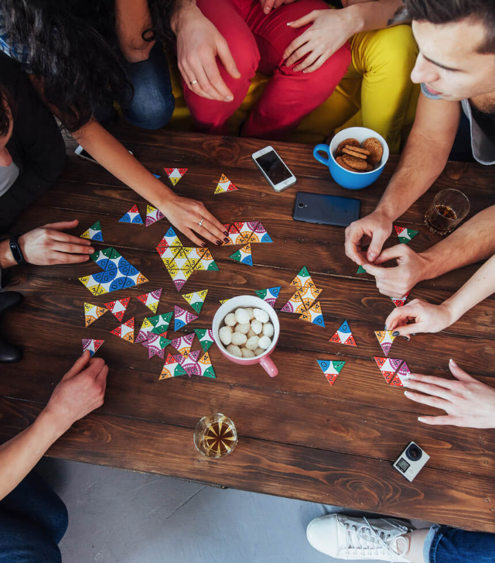
Implementation of logi-cal thinking games and contests
01.
Discover biodiversity in a fun way​
3
World environment day – June 10th 2022

Slide 4
Examples of contests and of games to implement
Different types of contests can be organized:
Photo contest on the biodiversity around the site
Waste-collection contest; the heavier bag wins (e.g., cigarette butt, cans, plastic, metals…)

Slide 5
Building installations promoting biodiversity
02.
Dedicate a small moment of your day to the construction of these facilities

Slide 6
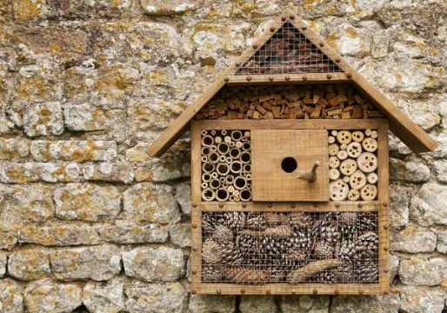
Insects hotel (pollinators and auxiliaries)
It is easy to build insect hotels for a lower cost. They are useful facilities for insects to spend the winter or lay eggs in summer.​
Tutorial for an Insects hotel
Identify natural materials (logs, bricks, straw, bamboo sticks). Choose holes of different sizes.​
Build the wooden frame. It must be strong enough to carry a significant weight (use chestnut, larch, Douglas fir)​
Provide a waterproof cover (slate roof for example).
Install the frame in a permanent location before filling it.​
Cut your materials to the desired length and fill in each space.​

Slide 7
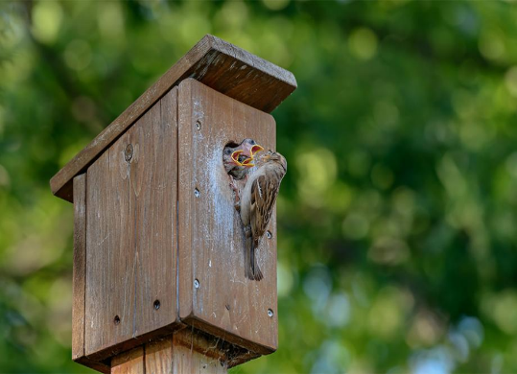
Birdhouse
Making a birdhouse is easy and helps preserve many species. Here is a method to make a letterbox birdhouse adapted to various passerine species (chickadees, tits, sparrows, nuthatches…) :
One bottom : 136 X 136 mm.
2 walls : 136 X 200-230 mm (trapezes).
A roof : 140 X 140 mm.
A back side : 136 X 230 mm.
A front face : 136 X 200 mm. The flight hole will be located at 150 mm minimum above the birdhouse’s floor. Its diameter will be 25 mm for blue tits, black tits or marsh tits, 28 mm for great tits, the black flycatcher, 32 mm for the house sparrow, the nuthatch, 45 mm for the European starling.

Slide 8
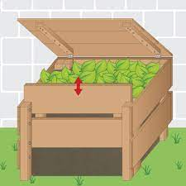
Compost
The goal is to reduce our waste and create a substrate serving as a fertilizer for a vegetable garden and ornamental plants.
We recommend to collect wooden pallets and gather them, in order to store waste within (look for wood that is not chemically treated)
It is generally recommended to use a cover to better control humidity: not too much rain so that it is not too wet, not too much sun so that it does not dry too quickly.

Slide 9
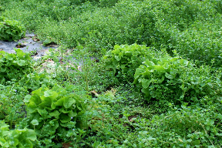
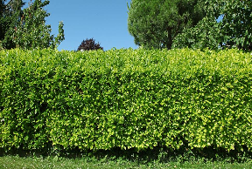
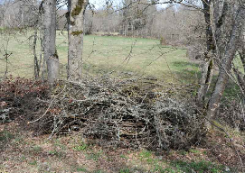
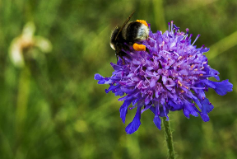
Other ideas of facilities and good practices to implement
Do not weed out your green areas, keep a few without them being invasive
Do not prune hedges: they constitute an ecosystem favorable to many species, birds that build their nests there, but also small mammals. Therefore, it is preferable not to prune your hedge and to wait until autumn to do so
Install small piles of branches under the hedges: they will serve as a habitat for small insects but also mammals such as hedgehogs for example
Install a flowered area with melliferous plants (wild and native flowers that attract pollinators) and non-invasive plants
Translated with www.DeepL.com/Translator (free version)

Slide 10
Organisation of outdoor visits & use of apps
03.
Take the time to get out and discover your environment and take care of it

Slide 11
List of outdoor activities
Visits to beekeeping farms in the region
Visits to museums that promote biodiversity
Discovery of the use of applications to help recognize biodiversity
Educational outings around biodiversity issues (hikes)
Waste collection around the site and/or plogging/eco-jogging activity: an activity that combines jogging and waste collection during the lunch break
List of applications useful to identify biodiversity
SPIPOLL (only in french)
PlantNET
BirdNET
Picture Mushroom
Tutorials are avalaible in the toolbox

Slide 12
Partnership with organizations and universities
04.
Involve external stakeholders near your site during your WED

Slide 13
List of partnerships/collaborations you could engage in
Bring in ecology/environment students and set up workshops such as those mentioned in part 02
Example : discussion booth
Bring in local NGOs and/or local organizations to raise awareness about biodiversity issues in the region
Example : Donges’ refinery invites ACROLA (ornithology NGO) on the 10th of June
Welcome school classes to discover biodiversity on site and/or organize workshops with them

Slide 14
Communication about the event
05.
Share with us your WED

Slide 15
Think about taking photos and videos during your world environment day on your site that you will share with us
Think about sharing with us your program and what activities you will provide. It will be useful for us or other site
World environment day – June10th 2022

Slide 16
Contacts and useful links
06.

Slide 17
links and contacts
You have access to the toolbox where you can find :
Posters
5 Films (1 per branch) highligthing our biodiversity actions
Quiz on biodiversity
Manager kit
List of applications to recognize biodiversity
Biodiversity booklet
Headquarters contacts
RC
Marie-Line Dumans
Maëlle Richard
EP
Antoine Escalas
Hannah Escoubet
GRP
Clément Lavigne
MS
Mathieu Vaissiere
Felix Lecompte-Boinet
World environment day – June10th 2022

Slide 18
Thank you.

