Slide 1
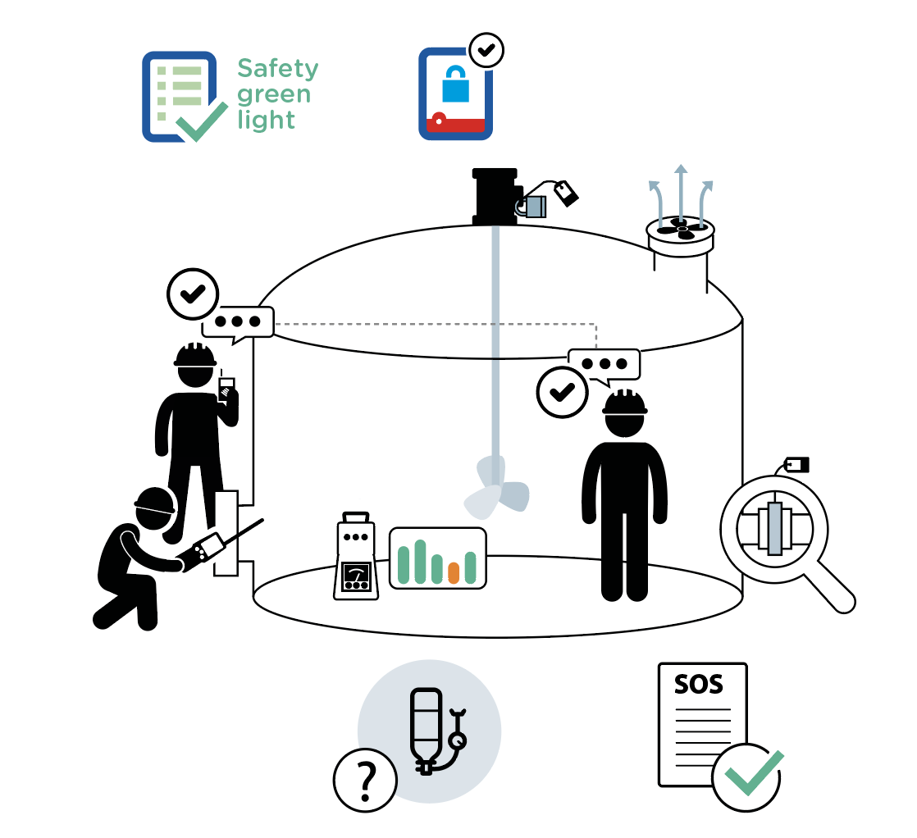
Confined spaces
September 2021
1 fatality related to confined space occurred within the Company in the last 10 years.
1
2
2
8
5
6
7
2
3
4
9
10

Slide 2
Confined spaces
September 2021
Location Date
Company observed Permit No.
POINTS TO BE CHECKED
YES
NO
N/A
1
2
Has the "Safety green light" been carried out?
Use the checklist "Work on de-energized systems" for each energy and answer: do all applicable points comply?
Has the atmosphere been checked prior to entry confined space?
3
4
5
6
Is atmosphere monitored (or checked regularly) during the confined space work?
Is the entry watch assigned and ensured at all times?
Is the number of entrants monitored (or regularly checked) at all times while working in a confined space?
Is communication between entry watch and entrants established and regularly tested (e.g. oral, visual
or radio)?
7
8
9
10
Is the confined space ventilated (natural or mechanical ventilation)?
When required by the work permit, is an adapted respiratory protection used?
Is the rescue plan known and ready to be initiated?
Compliance rate (Nb YES/applicable points): / ( %)
Comments
Name
Company Signature

