Slide 1
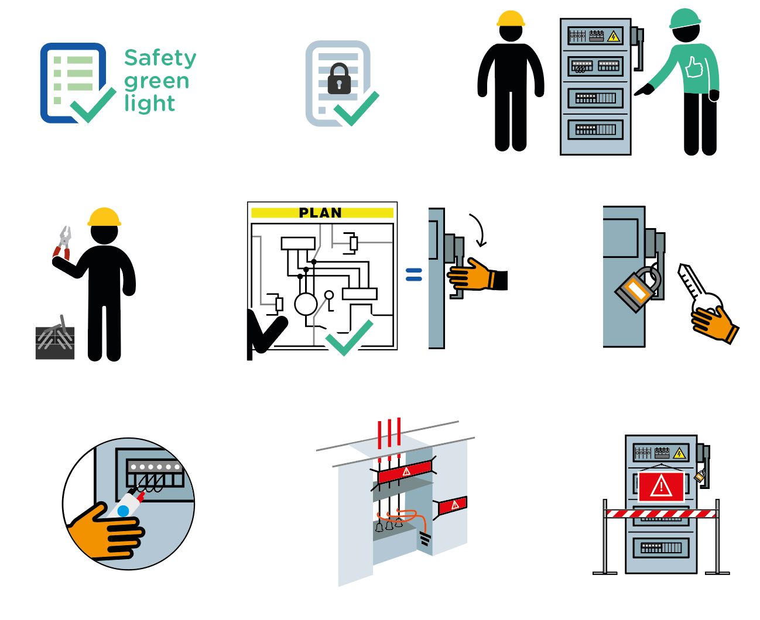
Work on electrical
June 2022
de-energized systems
11 fatalities related to work on powered systems occurred within the Company in the last 10 years.
1
2
3
4
5
6
7
8
9

Slide 2
Work on electrical
de-energized systems
June 2022
Location Date
Company observed Permit No.
YES
NO
N/A
POINTS TO BE CHECKED
Has the "Safety green light" been carried out? Has the representative of the workers received
the validated isolation certificate(s) corresponding
to the equipment involved in the work to be done?
Is the circuit or equipment on which the work is to be carried out identified in the field by an authorised person in the presence of a representative of the workers?
Do personnel performing the activity wear specific PPE for the task?
Are separation devices set in the identified position as per approved isolation diagram / plan? (master copies to be checked in the dedicated place)
3
4
5
6
7
Are separation devices locked and tagged?
Has the zero voltage testing been carried out by an authorized person and demonstrated to the representative of the workers?
Has the grounding / short circuiting been carried out on all conductors including neutral?
8
9
Are hazards on adjacent live parts signalled and are protections in place?
Compliance rate (Nb YES/applicable points): / ( %)
Comments
Name
Company Signature

