Slide 1
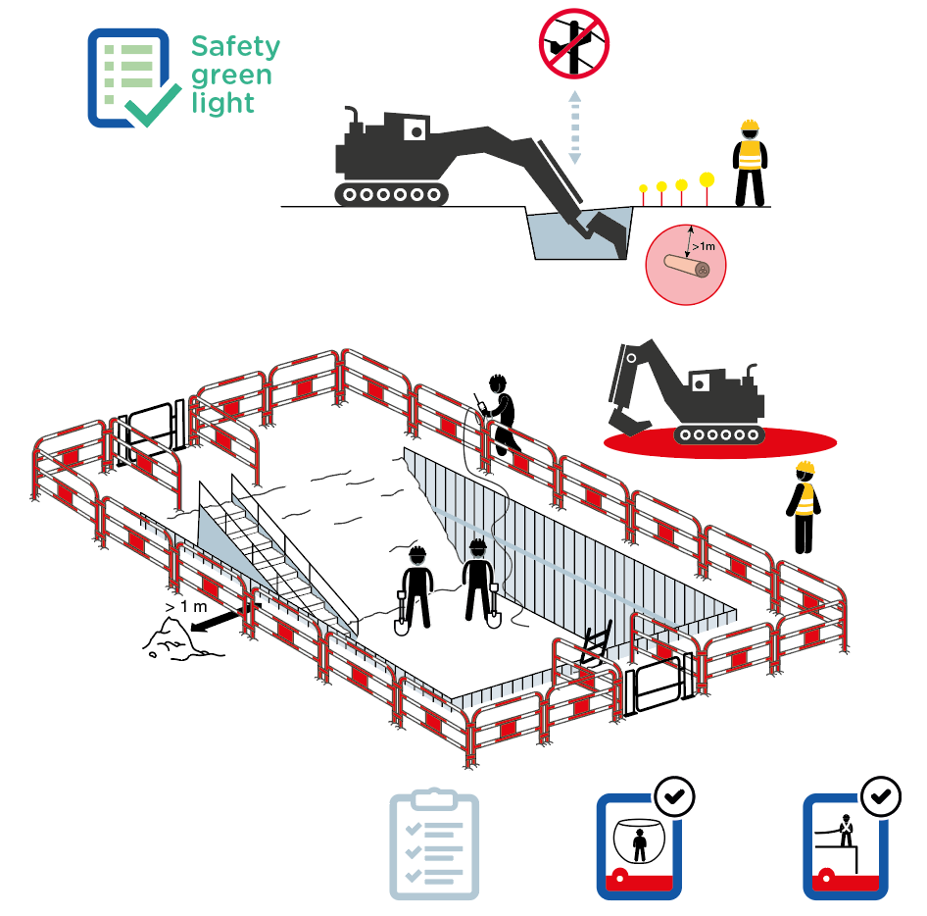
Excavation works
June 2022
More than 30 potentially serious events related to excavation work occurred within the Company in the last 5 years.
3
1
3
1
2
2
13
13
4
4
>1m
3
3
10
10
4
4
8
8
5
5
13
6
13
6
> 1 m
11
7
11
8
8
7
9
11
12
9
11
12

Slide 2
Excavation works
June 2022
Location Date
Company observed Permit No.
YES
NO
N/A
POINTS TO BE CHECKED
1
2
3
4
5
6
7
8
9
10
Has the "Safety green light" been carried out?
Have all identified underground networks been indicated on site?
Is a safe distance maintained from overhead power lines and underground networks (> 1 m - 3ft - if excavation
by «aggressive» methods)?
Are excavators on stable ground with nobody in the working radius of the machine?
Have protections against cave-in been installed before personnel enter the excavation?
Is the excavation footprint marked out (solid barriers if risk of people or vehicles falling)?
Is a safe distance of at least 1 m - 3 ft -, from the edge of the excavation kept free of excavation spoil, machinery or equipment?
Before personnel entry, has a safe means of entering and exiting the excavation (stairs, graded slopes
or ladders) been installed?
Has an inspection of the excavation been carried out before personnel enter?
If the atmosphere is potentially hazardous, has a gas test been performed prior to work or to entering
the excavation?
For the next two cases, use the listed check-list:
11 If confined space, “Confined spaces” check-list
12
13
If working at height - elevation > 1.5 m (5 ft) - “Work at height” check-list
If persons are entering the excavation where
the excavation is > 1.3 m (4 ft), or if the excavator operator does not have clear visibility or is working close to underground networks, is a supervisor present?
Compliance rate (Nb YES/applicable points): / ( %)
Comments
Name
Company Signature

