Slide 1
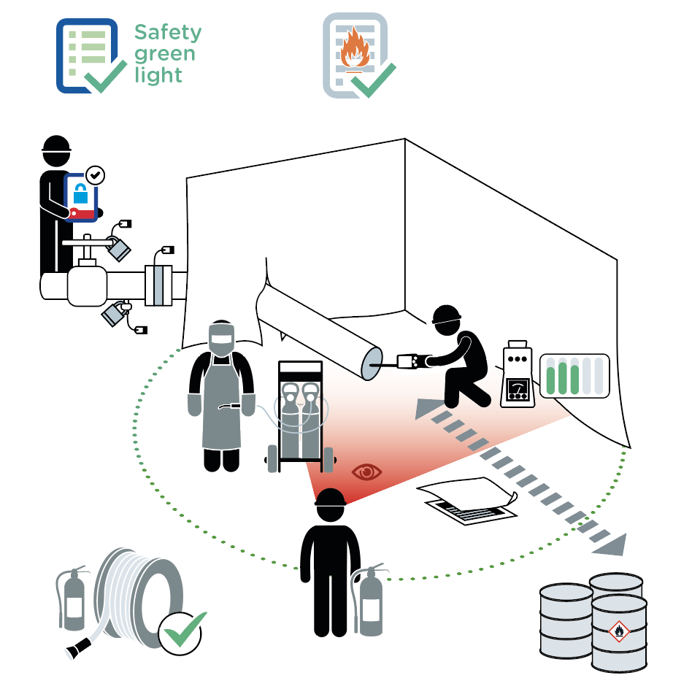
Hot work
September 2021
2 fatalities related to hot work occurred within the Company in the last 10 years.
1
2
3
9
5
6
4
7
8
10
11

Slide 2
Hot work
September 2021
Location Date
Company observed Permit No.
YES
NO
N/A
POINTS TO BE CHECKED
Has the "Safety green light" been carried out?
1
2
3
4
5
Is the hot work permit validated?
Use the checklist "Work on de-energized systems" for each energy and answer: do all applicable points comply?
Do personnel performing the activity wear specific PPE for the task?
In an area with a potentially explosive atmosphere, has a gas test been completed prior to hot work?
In an area with a potentially explosive atmosphere,
is continuous monitoring of the atmosphere or is gaz testing with a defined frequency carried out, and results monitored?
Are drains, openings and vents shielded?
6
7
8
9
10
11
Have all combustible materials been removed, covered or kept wet in the hot work area?
When required by the work permit, are spark protection covers in place?
Has firefighting equipement been inspected, is it available at hot work site and ready for use ?
When required by the work permit, is the fire watch in place?
Compliance rate (Nb YES/applicable points): / ( %)
Comments
Name
Company Signature

