Slide 1
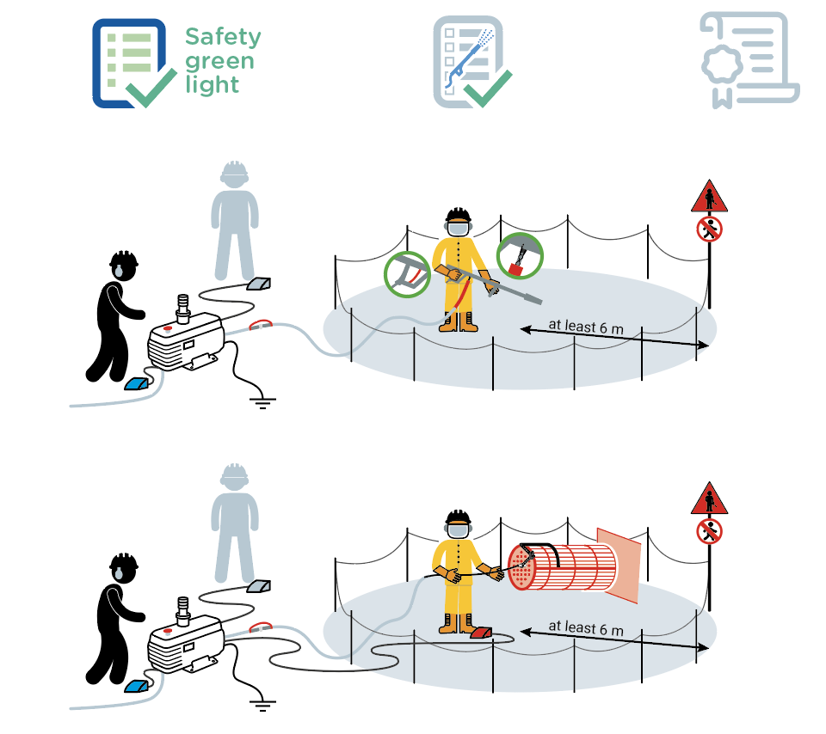
Manual high pressure water jet cleaning
September 2021
1 fatal accident related to high pressure water jet cleaning occurred within the Company in the last 10 years.
1
2
4
6
3
11
6
5
9
7
10
8
6
3
12
13
6
9
7
10
5
8

Slide 2
Manual high pressure water jet cleaning
September 2021
Location Date
Company observed Permit No.
YES
NO
N/A
POINTS TO BE CHECKED
Has the "Safety green light" been carried out?
Has the checklist before start-up been completed by the operations team?
Are personnel in the barricaded area wearing the task-specific PPE?
Do personnel have a training / competence certificate?
Is the hose fitted with a tool (gun, nozzle etc) controlled by an active hold-to-run command available to the operator?
Is the operator constantly observed by the machine operator equipped with an instant depressurization control device? (NB: by a dedicated observer if visibility between the machine operator and the operator is limited)
Is the machine operator close enough to the machine to activate the emergency stop ?
Is the working area clear?
Are suitable barriers and signs in place around
the jetting area? (at least 6 m - 20 ft from the nozzle)
Are all the flexible connections fittedwith an anti-whip device?
HP waterjet using a jet gun: does it have a hose sleeve and, if required locally, is an anti-whip device fitted between the jet gun and the hose?
HP waterjet using a flexible lance: is it fitted with an anti-withdrawal device?
HP waterjet work on ducts or equipment open
at both ends: is a screen installed at the open end of the equipment?
1
2
3
4
5
6
7
8
9
10
11
12
13
Compliance rate (Nb YES/applicable points): / ( %)
Comments
Name
Company Signature

