Slide 1
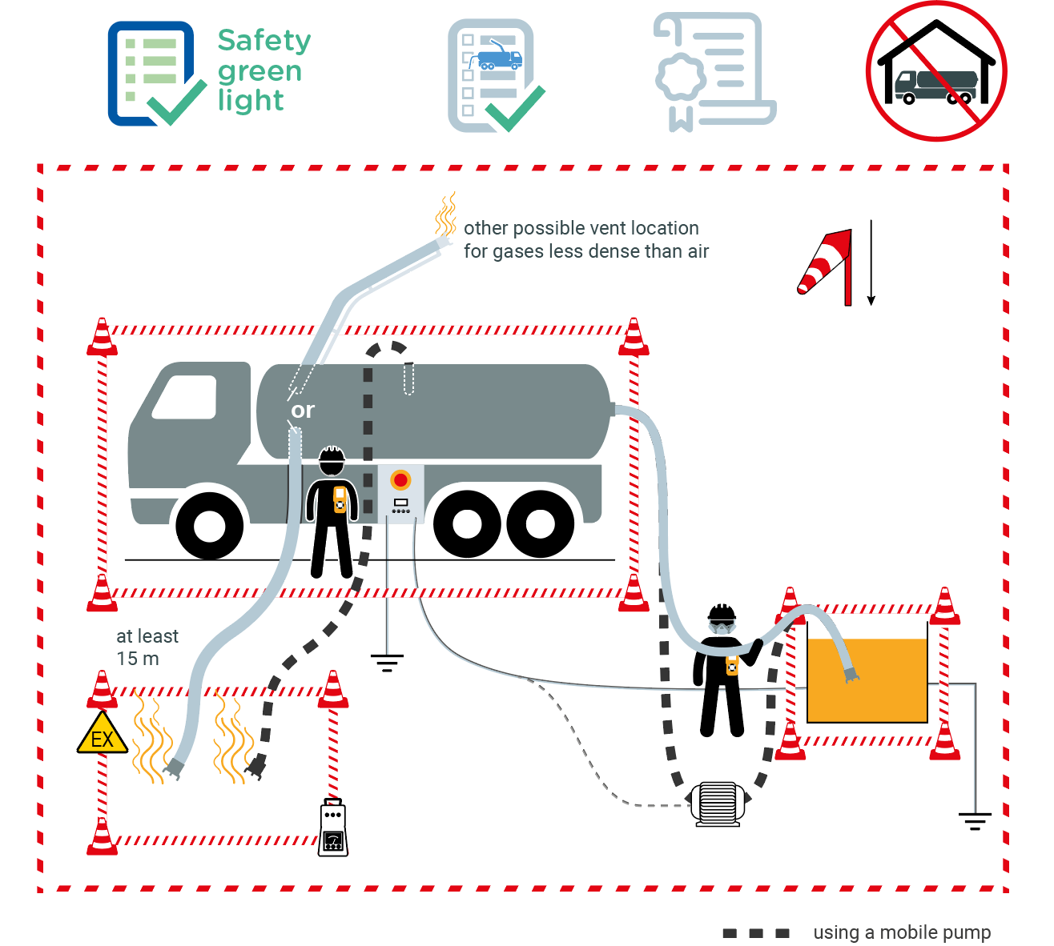
Industrial cleaning using mobile pump and vacuum truck
June 2022
2 potentially serious events related to pumping activity occurred within the Company in the last 5 years.
1
2
3
4
6
4
7
10
9
9
8
5
7
7
6
9
8

Slide 2
Industrial cleaning
June 2022
Location Date
Company observed Permit No.
YES
NO
N/A
POINTS TO BE CHECKED
1
2
3
4
Has the "Safety green light" been carried out?
Has the checklist before start-up been completed by the operations team?
Do the operator and machine operator have a training/ competency certificate for their function?
Is the working area positioned according to the wind direction and are the truck and the vents located outside buildings?
Are the team members aware of the product to be pumped (flammable, toxic, etc.) and has the
compatibility with the equipements been checked?
5
Where it is not possible to collect the vapors, are they vented to a safe area (at least 15 m - 50ft from the truck and downwind; if not and only for gases less dense than air, at least 5 m - 17 ft above the truck)?
6
7
Is the area around the truck, the pumping location
and the vents barricaded and the vent location clearly
flagged up? (in service stations: barricades around
the worksite perimeter)
8
Are grounding and equipotential bonding in place?
9
Is the atmosphere at the pumping site, at the truck and at the vent location constantly monitored?
10
Is the machine operator positioned within reach of the pump emergency stop?
Compliance rate (Nb YES/applicable points): / ( %)
Comments
Name
Company Signature

