Slide 1
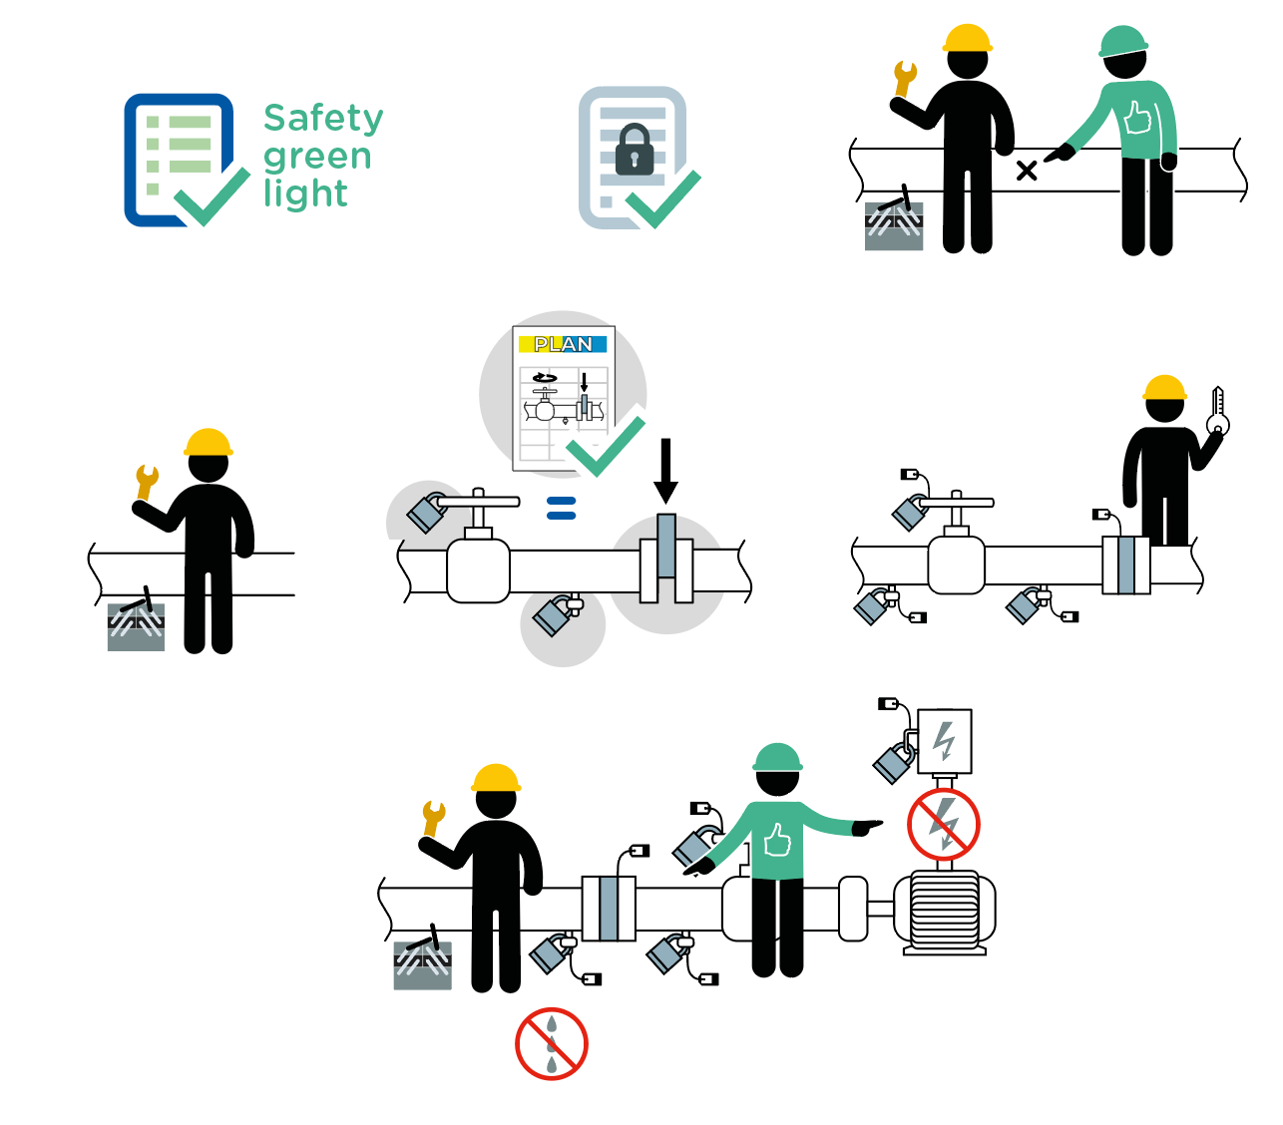
Work on process
June 2022
de-energized systems
(gas, liquids, solids)
11 fatalities related to work on powered systems occurred within the Company in the last 10 years.
1
2
3
4
5
6
7

Slide 2
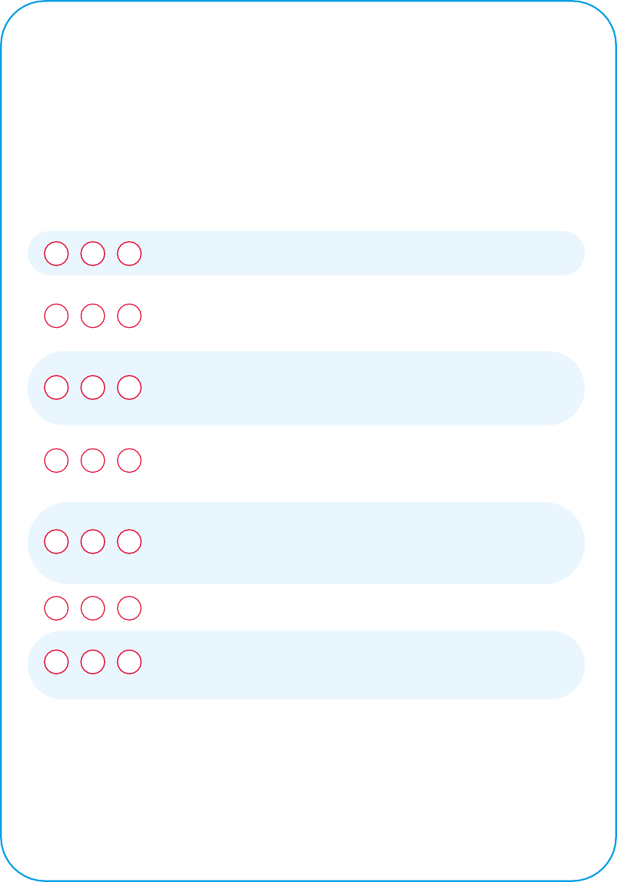
Work on process
de-energized systems
June 2022
Location Date
Company observed Permit No.
YES
NO
N/A
POINTS TO BE CHECKED
Has the "Safety green light" been carried out?
1
2
Has the representative of the workers received
the validated isolation certificate(s) corresponding to the equipment involved in the work to be done?
3
Is the circuit or equipment on which the work is to be carried out identified in the field by an authorised person and in the presence of a representative of the workers?
Is the personnel performing the activity equipped with
4 task-specific PPE and, in an area with a potentially
explosive atmosphere, non-sparking tools?
5
Are isolation devices set in the identified position as per approved isolation diagram / plan?
(master copies to be checked in the dedicated place)
6
Has the absence of energy been demonstrated
7 by an authorized person and in the presence
of a representative of the workers?
Are isolation devices locked and tagged?
Compliance rate (Nb YES/applicable points):
/
( %)
Comments
Name
Company Signature

