Slide 1
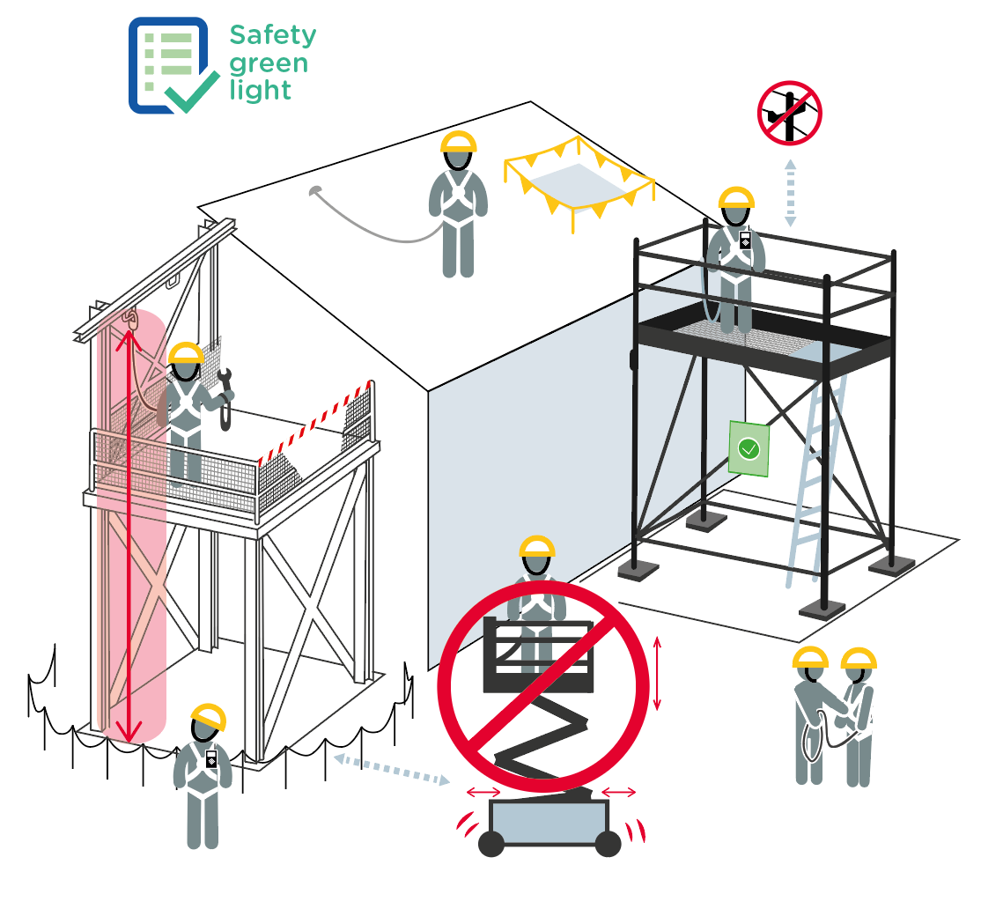
Work at height
June 2022
11 fatalities related to work at height occurred within the Company in the last 10 years.
1
8
7
2
5
6
9
8
10
4
9
11
3
6
7

Slide 2
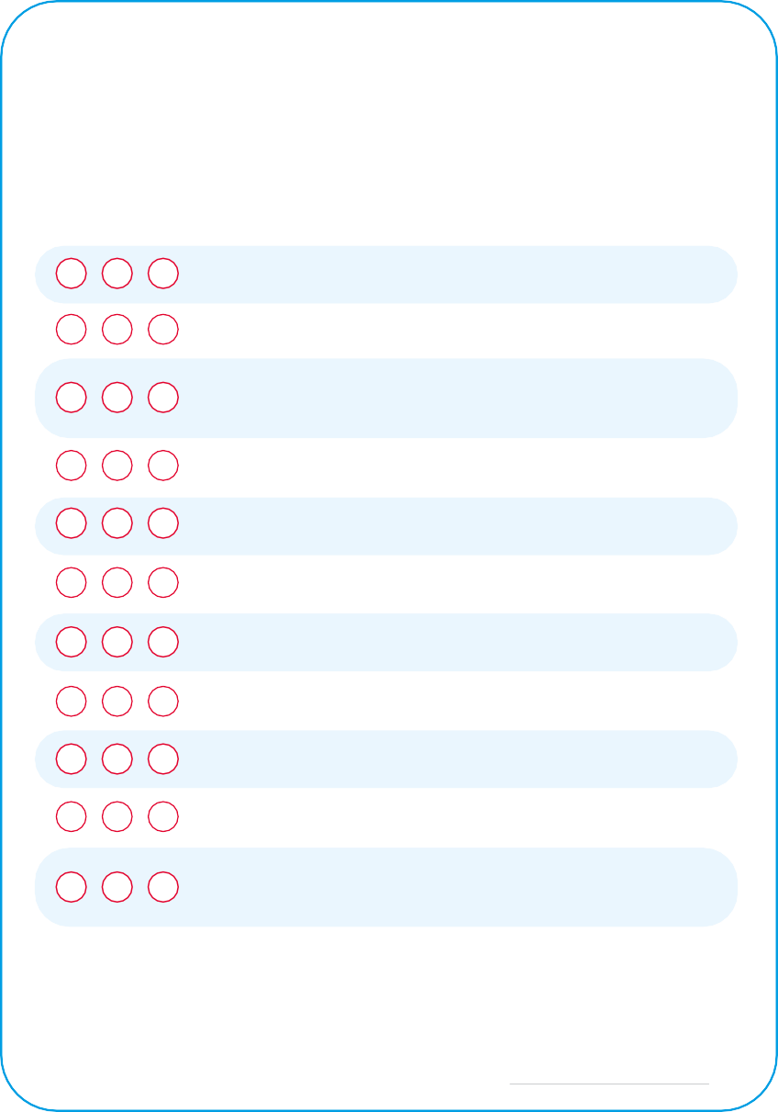
Work at height
June 2022
Location Date
Company observed Permit No.
YES
NO
N/A
POINTS TO BE CHECKED
Has the "Safety green light" been carried out?
1
2
3
4
5
6
7
8
9
10
11
Is the safety helmet with attached chin strap worn by all personnel present at height?
When the safety harness is required, is it worn and adjusted (for ex: outside fixed barriers or in a MEWP - Mobile Elevating Working Platform)?
Is the potential falling path clear of obstructions when working with a safety harness?
Are all personnel wearing a safety harness tied off to pre-defined anchor points?
Are work crew aware that team member wearing a harness should remain visible or audible?
Is safe clearance from potential hazards considered (powerlines, coactivity)?
Are gaps, holes or fragile areas in floorings, guard rails and roofs, identified and / or protected?
Are tools and work materials secured to avoid dropped objects or the zone below is marked off?
Has the scaffold been inspected and declared safe for use?
Is the work crew aware that a deployed MEWP
or a mobile scaffold with personnel on it, shall not be moved?
Compliance rate (Nb YES/applicable points): / ( %)
Comments
Name
Company Signature

