Slide 1
Safety Green Light
Training kit

Slide 2
Why this tool?
« See something, say something » - Start / re-start ritual
To prevent active errors such as errors in applying rules or errors of diagnosis or “routine” errors but also latent errors (traps set in the organization, for example: it is not the right equipment, or it is not made available).
To increase situational awareness
The time allocated to stop allows to think, reassess and remember the task to be performed. It avoids to rush.
The open questions give time and rooms for each worker to say something, to intervene
It reinforces the use of the Stop Card
The brain has the tendency to work in « routine » mode. A way to exit this mode to a « conscious » mode is to ask open questions to create the vigilance and the reflection.
2

Slide 3
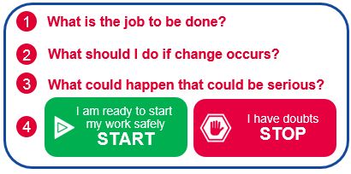
What it is?
Last opportunity to say something
The safety green light is realized for all work carried out under a work permit
When the work is ready to be launched (signed work permit)
Each worker thinks about four open questions and interacts with colleagues
Each participant validates on the back of the work permit or any other equivalent support before starting
This action is quick and is brief
this is the last opportunity to speak, to talk before launching the work.
3
2021/10 – Safety Green Light

Slide 4
How, when & where?
Implementation, duration, location
Each member of the team involved in this work, including in the case of a lone worker
Asks the 4 open questions, answers them and decides whether or not to start the work
This action takes place at the location of the intervention and lasts only a few minutes
It is carried out at each start of work or each time that work starts again, after a change of team or in the case of modification of the working environment
1
What is the job to be done?
2
What should I do if change occurs?
3
What could happen that could be serious?
I am ready to start my work safely
START
I have doubts
STOP
4
4
2021/10 – Safety Green Light

Slide 5
Who’s is doing it and for what?
Each team member to answer the questions
All those involved in the execution of the work, both the personnel of the contractor company and the personnel of Total, in particular when the permit requires their presence
Each stakeholder asks the 4 open questions, decides if the work can start or resume then valid on the back of the permit or on any other medium for starting work
1
What is the job to be done?
2
What should I do if change occurs?
3
What could happen that could be serious?
I am ready to start my work safely
START
I have doubts
STOP
4
5

Slide 6
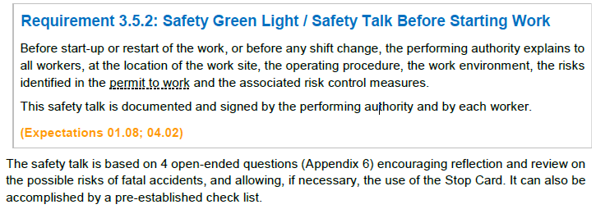
What is mandatory, what is recommended ?
The Company Rule - Permit to Work process
This action is made mandatory by the CR GR HSE 402 rule (Requirement 3.5.2).
Existing site documents in terms of work start-up review (LMRA type, minute to think, tool box talk, etc.) must be adapted and uniformized to be in line with the safety green light
The format used to animate the safety green light is not mandatory.
6

Slide 7
Reporting
KPI : how many site have implemented it ?
Each entity or affiliate will be questioned on a regular basis by the HSE / Branch to declare its implementation.
This action will be locally included in the permit to work documents / process.
7

Slide 8
What is the tool?
SAFETY GREEN LIGHT?
What: pre-job ritual to reflect on life-threatening hazards
Who: all personnel involved in the task including Total personnel if present
Where: on all sites (including remote) for all works performed under a permit-to-work
When:
Every job under a work permit
Everything is ready to start a job
Every time a job is about to start, to re-start, after a shift handover and any modification
How long: few minutes, must be quick
How:
Standard included in HSE Company Rule related to Permit to Work (CR-GR-HSE-402)
Each worker reflects on the four questions and interact with his co-workers
Each worker signs at the back of the permit-to-work prior to starting
1
What is the job to be done?
At what exact location?
Do I understand my role and am I able to do it? Have the procedure and work permit been explained to me?
Do I have the right tools/protective equipment's for the work?
2
What should I do if change occurs?
Change in conditions (environment, co-activities, etc.) during the course of work (need for a tool not initially planned, operating procedure or risk not initially identified, etc.)?
3
What could happen that could be serious?
Is there a risk of a fatal accident?
Can someone hurt me, or can I hurt someone?
What will protect me?
I am ready to start my work safely
START
I have doubts
STOP
4
I report to my team leader
8
2021/10 – Safety Green Light

Slide 9
Tools and training
Video, safety induction…
It is necessary to inform and explain this action to Group staff and to the staff of the contractors involved.
This action should be included in the safety induction / introduction to site safety and in all other training related to work safety
9

Slide 10
Simple & practical initiative
Few points of vigilance however :
Sustainability of the tool after 6 months that will request involvement, recognition…
Lone worker performing the task alone and/or far from supervision
Discussing general information instead of the specific steps in an operation
Giving a speech instead of encouraging the proactive involvement of the people who are to perform the tasks
Lack of communication in the team
Not expressing your concerns or not asking questions
Talking about the steps in the operation as if they were quoting from an operating manual rather than discussing the applicability of the instructions
Not being attentive to any reactions or alerts expressed
Not talking about potential errors and how to avoid them : absence of feedback
Making the briefing too long
Confusion with existing tools → Successful if kept simple
10

Slide 11
In short
Last time to say something, verify, say STOP
Focus life-threatening hazards
Need to promote that ritual, be exemplary, show how to do it
Keep it simple and quick, use the video as an example, display the 4 open questions
11

