Slide 1
LIFE SAVING CHECKS
Training kit
Rev. 2

Slide 2
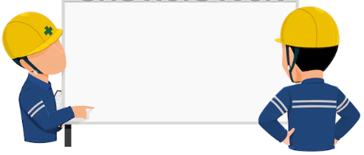
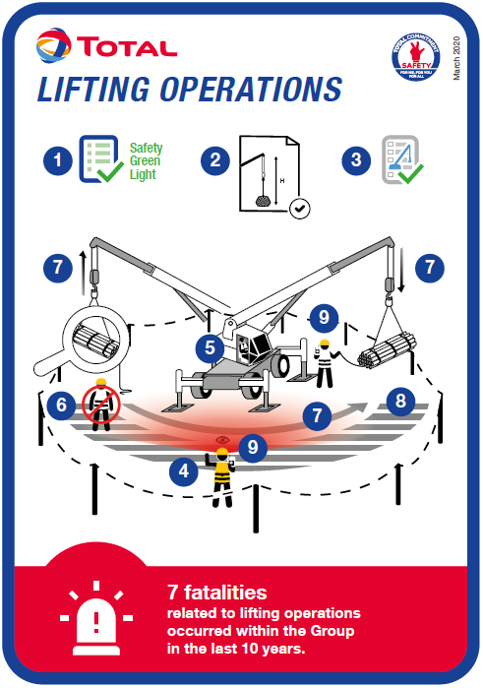
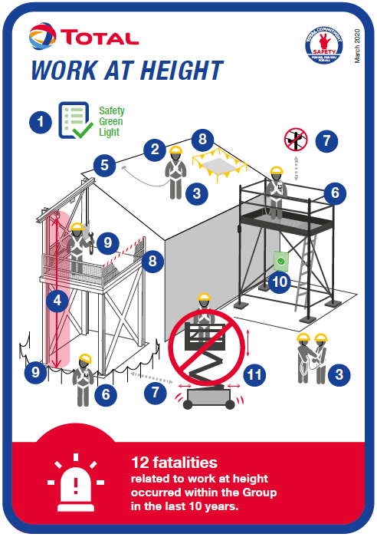
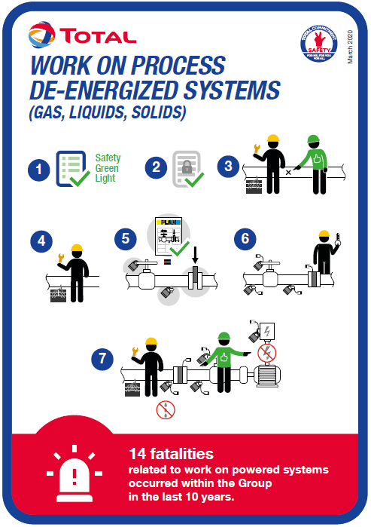
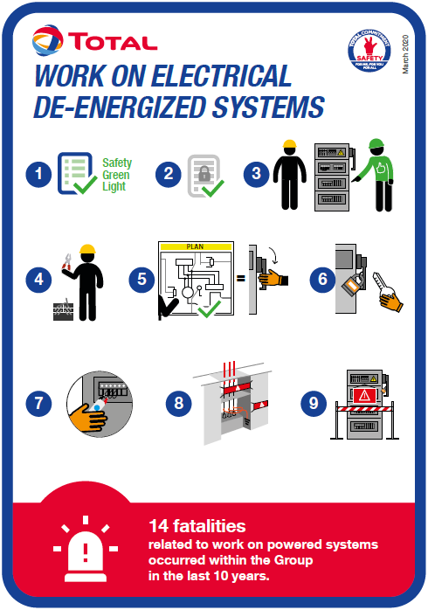
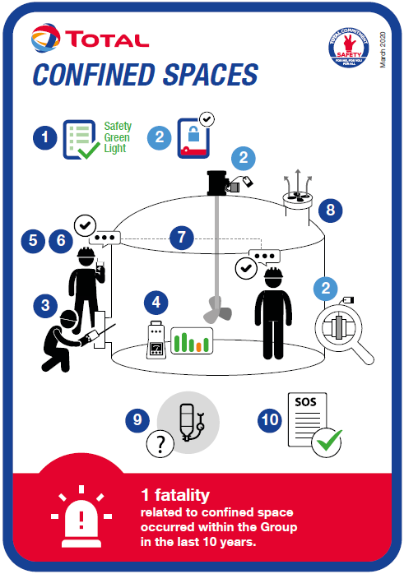
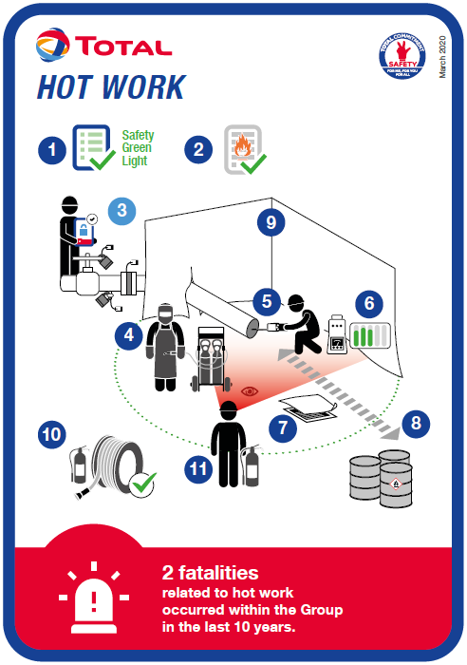
Presentation of the action
« life saving checks »
2
2021/10 – Life saving checks

Slide 3





Why?
The objective is to carry out field checks on the basis of specific checklists in order to prevent fatal accidents.
These field checks cover at least the 5 most important life-threatening activities for TOTAL:
Work at height
Work on isolated systems
Lifting operations
Working in confined spaces
Hot work
3
2021/10 – Life saving checks

Slide 4


Who?
Field checks are carried out by TOTAL or Contractor personnel. These field checks are not necessarily carried out jointly (TOTAL with Contractor).
Field checks are carried out by first level supervisors, middle managers, top management, HSE or any other controller identified/designated by each party.
4
2021/10 – Life saving checks

Slide 5




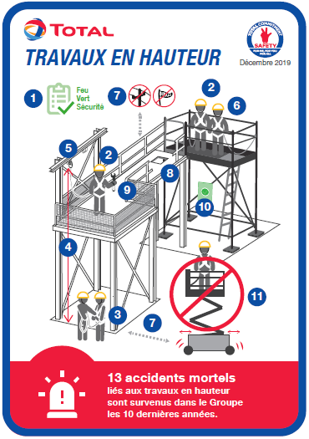


Where, when & how?
The checks are carried out in the field, where the life-threatening activity takes place.
The observation of life-threatening activities is done during the execution of works.
Field checks of a life-threatening activity are brief (15’) in order to increase their number.
The use of checklists and associated diagrams helps to observe non-conformities. In this case, the controller intervenes and stops the work in progress.
The compliance rate is assessed based on the verification of the points of the checklists.
5
2021/10 – Life saving checks

Slide 6





Where, when & how?
Field checks do not record the names of individuals but only that of the company observed (TOTAL or Contractor company).
The results of these field checks are recorded in a common system.
The affiliates and the entities themselves set the target for the number of field checks to be carried out per month by the stakeholders (TOTAL and Contractors).
The results of the field checks are consolidated on a weekly basis with a local display of the compliance rate per company (TOTAL and Contractors)
The purpose of the display is to inform in order to identify the most vulnerable safety conditions and to progress collectively.
6
2021/10 – Life saving checks

Slide 7

Reporting
Local KPIs are defined as follows:
  The control rate (%) of life-threatening activities, i.e. the number of field checks carried out vs. the target for the number of field checks to be carried out per month, as set by the entity/affiliate.
  The compliance rate (%) of each company (TOTAL or Contractor) with regard to the number of field checks of life-threatening activities carried out.
KPI to report on a monthly basis:
  The number of field checks carried out must be communicated monthly to HSE/Branch for consolidation at Group level.
7
2021/10 – Life saving checks

Slide 8


What is imposed, what is optional
Imposed:
  The implementation of daily field checks for at least the top 5 of life-threatening activities.
  Monitoring of associated KPIs.
Optional:
  The content of the checklists.
  The format of the checklists.
  Models of checklists are made available to entities/affiliates to guide them as best practice.
8
2021/10 – Life saving checks

Slide 9
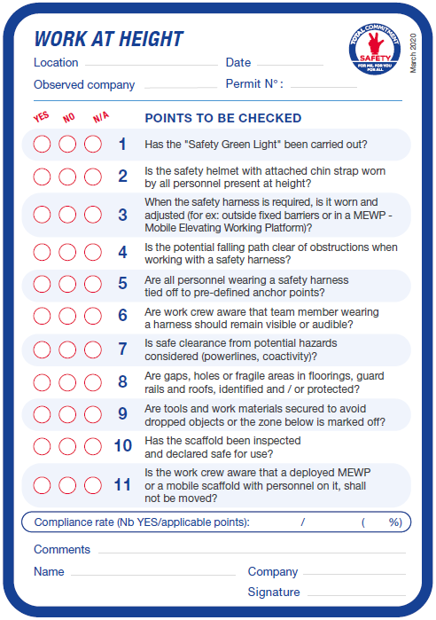
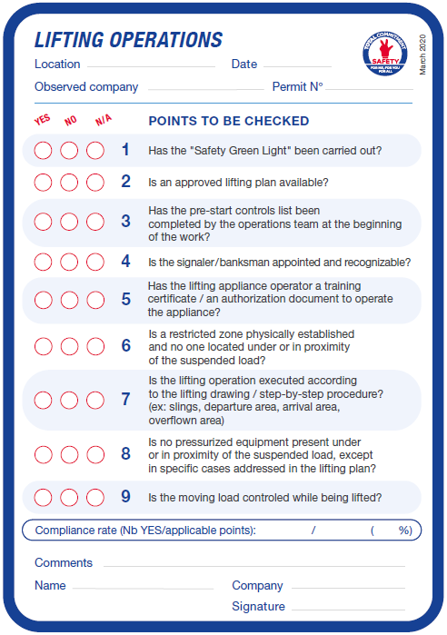
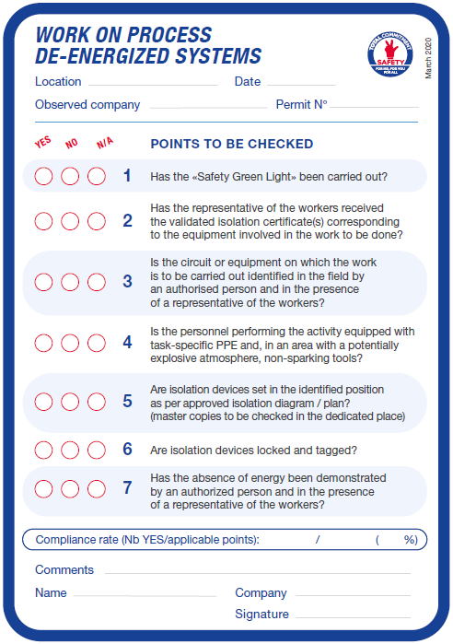
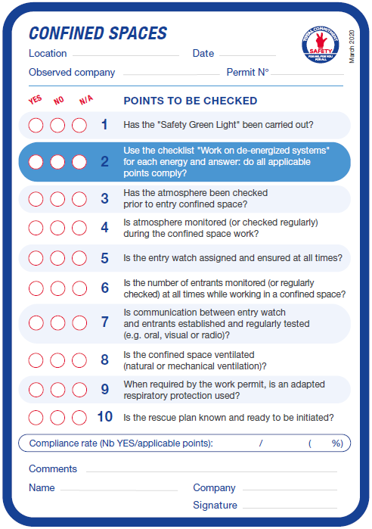
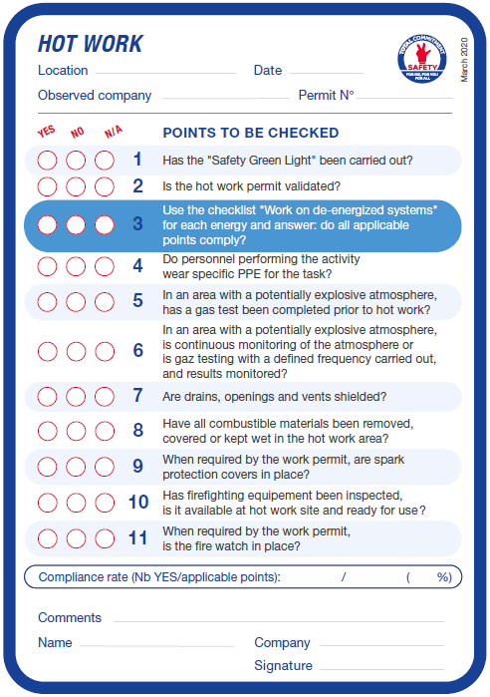
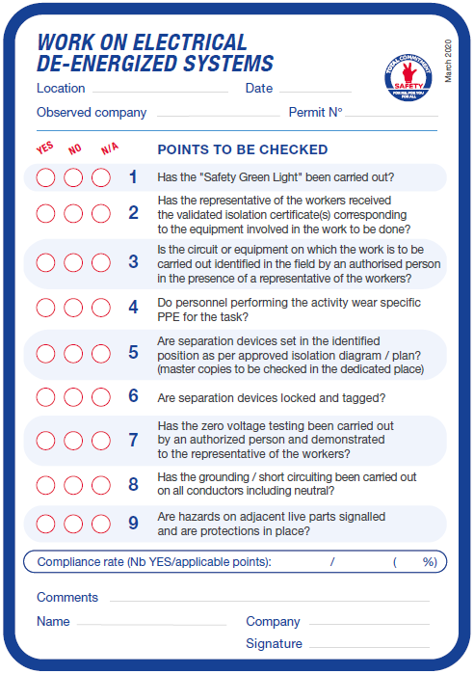
Tools
Checklists covering the top 5 life-threatening activities, with the diagram representing the activity on the front, and the points to check on the back.
9
2021/10 – Life saving checks

Slide 10
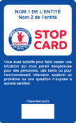
Tools
Example of a checklist:
Diagram representing the life-threatening activity and the points to check
Checklist of points to check on the life-threatening activity
Name of the observed company, not of the personnel involved
Numbered points to check, corresponding to the questions in the checklist
Non-compliant point
= stop
activity
Reminder of the number of fatal accidents linked to the respective activity
Calculation of the compliance rate on the total of the points checked and applicable
10
2021/10 – Life saving checks

Slide 11




Tools
The origin of the points to check in the checklists are:
  The « must » and « must not » of the Golden Rules.
  Points from other sources (e.g. IOGP Life Saving Rules...).
  By definition the points to check are:
  The checklists will be accompanied by a guide and a digital tool in order to facilitate the field checks and their statistical processing.
Observable
Proven
Life saving conditions
11
2021/10 – Life saving checks

Slide 12
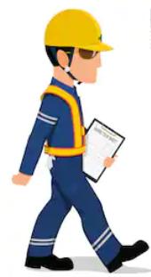
Conducting « Life Saving Checks » in the field
12
2021/10 – Life saving checks

Slide 13
Conducting a field check
Prepare the field check
Organize the field check by asking the operational manager (or any designated person) about the schedule of life-threatening activities.
Go out in the field
With the agreement of the person responsible, go to the work site on the agreed date/time, while being equipped with the appropriate PPE and with the checklist(s) corresponding to the activity.
Introduce yourself
Arrived at the work site, introduce yourself and explain to the workers the objective of field check.
13
2021/10 – Life saving checks

Slide 14
Conducting a field check
How to conduct oneself
Observe the activity on the basis of the points to be checked cited in the checklist, by asking additional questions to the workers, if necessary.
Keep in mind that this is a compliance check based on observable/proven elements and not a safety tour – therefore limit discussions with workers on subjects related to points to check in the checklist.
Perform the field check
Based on the checklist corresponding to the checked activity and using the diagram, check "YES", "NO" or "N/A" per point to check and calculate the compliance rate.
14
2021/10 – Life saving checks

Slide 15
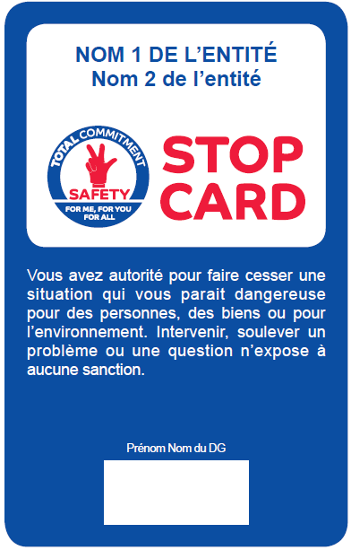

Conducting a field check
Intervening
When observing a non-compliant point (ref. checklist) or when detecting any other risk situation, error, oversight or situation likely to develop into an accident, the controller has the authority to stop the activity and this according to the principles of the use of the Stop Card (ref. GM-GR-SEC-029).
Feedback
If justified by the result of the field check or other elements/behavior observed, it is particularly important to immediately give positive feedback to the worker(s).
Report
In general, the compliance rate for the checked activity is recorded in the common system of the entity/affiliate.
15
2021/10 – Life saving checks

Slide 16
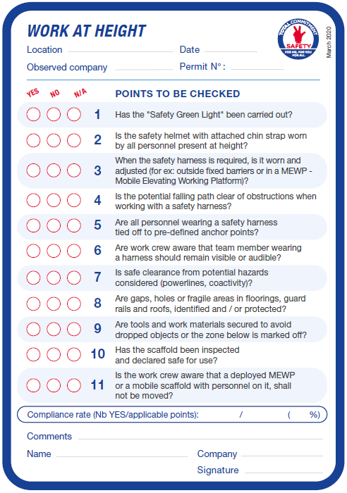

Guidance – observation of a non-compliant point
When observing a non-compliant point:
  The controller intervenes : that can mean anything from asking a simple question to make sure there's no danger to stopping the work in progress. The interruption gives a chance to start a conversation with the workers and their supervisor to solve the problem observed.
  If necessary, changes to the way of working are made before work is resumed.
  If the problem can't be solved immediately, work is suspended until the appropriate measures can be taken.
  Use of the Stop Card is then reported locally, per the reporting procedure put in place. This identifies areas for improvement and makes it easier to share experiences.
16
2021/10 – Life saving checks

Slide 17
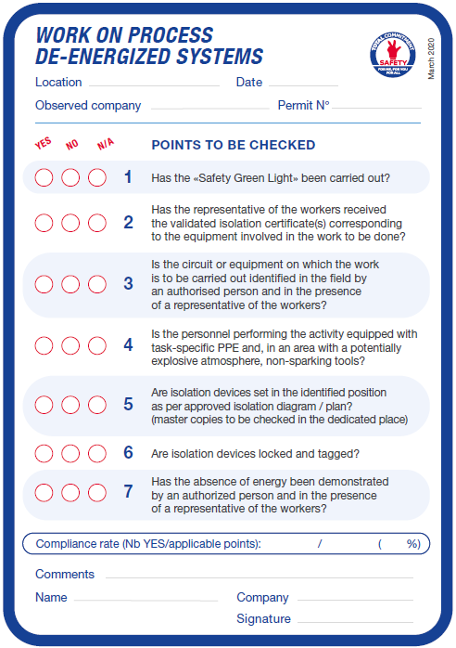
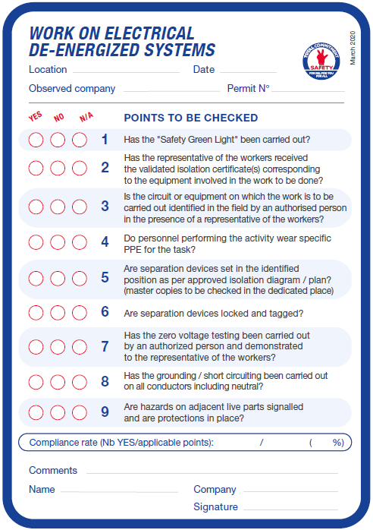
Guidance – DE-energized systems checklists
For work on de-energized systems, there are 2 checklists covering:
  Work on process de-energized systems.
  Work on electrical de-energized systems.
  Depending on the system on which the works take place, it will be necessary to apply one of the 2 checklists, or both of them.
Checklist for work on process de-energized systems
Checklist for work on electrical de-energized systems
17
2021/10 – Life saving checks

Slide 18
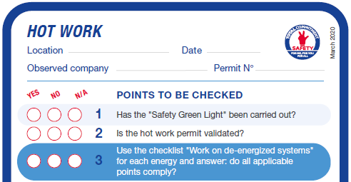
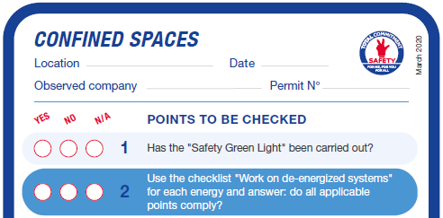
Guidance – referral to other checklists
One point to check in the checklists concerning:
  Hot work
  Confined spaces
  refers to the checklists concerning works on de-energized systems, i.e. “Work on process de-energized systems" and/or " Work on electrical de-energized systems ".
  When checking these activities, it is important to check the points in the “Work on process de-energized systems" and/or " Work on electrical de-energized systems “ checklists, in addition to the activity-specific checklist.
18
2021/10 – Life saving checks

Slide 19

Guidance – REFERRAL TO other checklists
Example: inspection works inside a storage tank with an agitator.
The checklists that are applicable :
  Checklist “Work on process de-energized systems”: isolation of the storage tank from the process
  Checklist “Work on electrical de-energized systems”: electrical isolation of the mixer
  Checklist “Confined spaces”: entry in the storage tank for inspection
Life Saving Checks of inspection works inside a storage tank with an agitator
=
19
2021/10 – Life saving checks

Slide 20
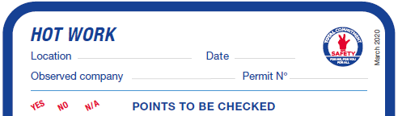
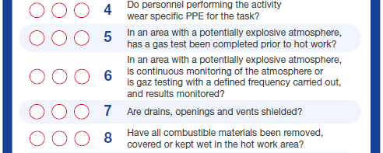
Guidance – conformity assessment
Conformity assessment:
  If a point to check concerns several elements, and if among these one element is not in conformity, then the point will be marked as non-compliant.
  The compliance of a point to be checked corresponds to the situation as initially observed, i.e. before correction/regularization of the situation (allowing the resumption of work).
Example: checklist Hot works, point #7
If it is observed that among the 3 drains present in the hot work zone there is one which is not shielded, then point #7 must be evaluated as non-compliant
20
2021/10 – Life saving checks

Slide 21

Guidance – calculation of compliance rate
Calculation of compliance rate:
  Add up all the points assessed as “YES" or "NO"
  Add up all the points assessed as “YES"
  Compliance rate =
the sum of all points assessed as « YES »
the sum of all points assessed as « YES » or « NO »
Example: checklist Work at height
Compliance rate = 7 / 9 (78%)
21
2021/10 – Life saving checks

Slide 22

Questions & answers
Can activities be interrupted during the life-saving checks ?
Yes, the life-saving checks may lead to an interruption of the crew’s work, provided this does not jeopardize the safe execution of activities.
Are the checks carried out by specialists in the activity ? Do the questions require technical knowledge or skills ?
No, the checks are to be carried out by TOTAL’s top-level management, line management, site HSE and supervisors, and by their counterparts of the Contractor company.
The checklists were designed such that everyone can carry out the checks based on observable, proven elements.
22
2021/10 – Life saving checks

Slide 23
Questions & answers
What activities are to be checked ?
Life-saving checks concern all life-threatening activities performed with or without a work permit by TOTAL personnel (for example the lock out/isolation of an equipment), or by Contractor personnel.
As a minimum, the 5 most important life-threatening activities for TOTAL are subject to life-saving checks, but the entities and affiliates are encouraged to add to this list other life-threatening activities, if relevant.
Is this an additional activity for people who are on a site ?
Observing the compliance rate with the Golden Rules is part of the Maestro expectations (09.03).
Life-saving checks on this subject already take place on many sites but need to be widespread, intensified and integrated by Contractor companies.
23
2021/10 – Life saving checks

Slide 24
Questions & answers
What if the entity/affiliate already has checklists for one or more of the five life-threatening activities ?
The content and format of the checklists provided as a guidance. But any existing checklists of the entity/affiliate must be consistent with the Life Saving Checks.
When certain points are non-compliant, what kind of response should be given, and how should work be resumed ?
If certain actions or situations are perceived to be high-risk or likely to develop into an accident: step in and stop work in progress where appropriate, while applying the principles of the Stop Card.
Similarly, if a good practice or behavior are observed, positive and immediate recognition must be given; this intensifies positive HSE behavior.
24
2021/10 – Life saving checks

Slide 25
Questions & answers
Where to find the checklists and supporting documents regarding the action « Life Saving Checks »?
Everything is available in the HSE Toolbox menu « Our lives first » :
  Checklists for the 5 most important life-threatening activities for TOTAL and the additional checklists for other life threatening activities (formats PDF, PPT* and INdesign*)
  Training kit (PPT)
  GM “Life Saving Checks” (Word)
  Action card A4 (Word)
  Printable version A4/A3 of the images for practical exercises
* Editable file format, allowing the branches/entities/affiliates to adapt and/or translate the content of the checklists
25
2021/10 – Life saving checks

Slide 26
Questions & answers
What is the rationale behind this action ?
Life-saving checks encourage compliance during life-threatening activities.
The principle is to reinforce respect for the rules as one of the key competencies of safety leadership that have the most impact on safety performance.
26
2021/10 – Life saving checks

