Slide 1
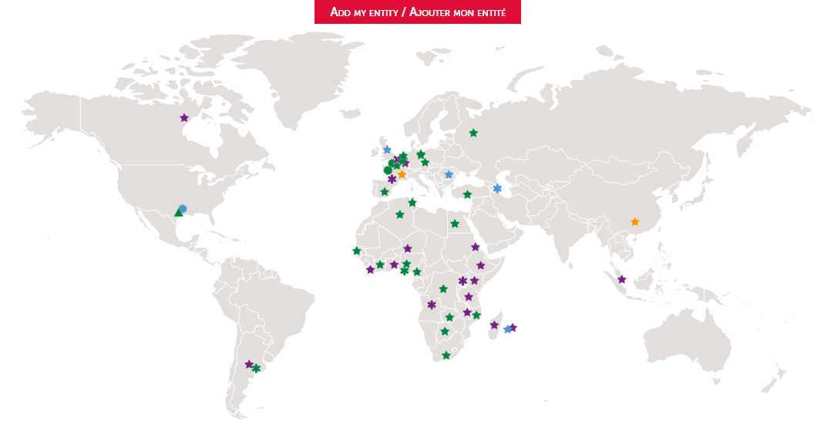
Contacts and useful links
Your contacts:
Generic e-mail address:
hd.fhos-dc-safetyfornewrecruits@total.com
TLS training manager:
gs.tls-hr4u@total.com
Some useful links...
HSE TOOLBOX
SAFETY ACADEMY
SAFETYPASS CARD
THE 12 GOLDEN RULES

Slide 2
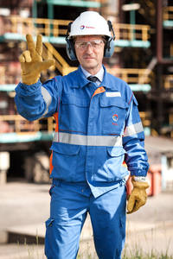
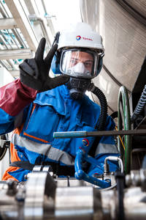
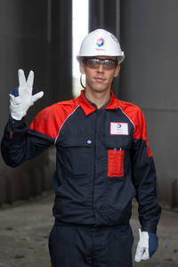
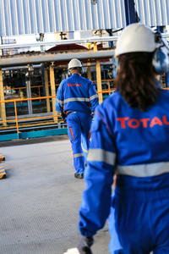
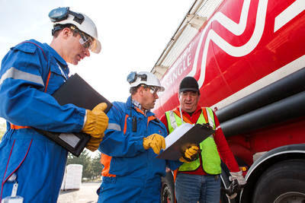
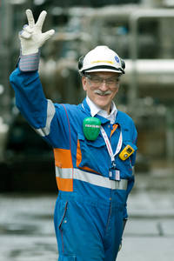
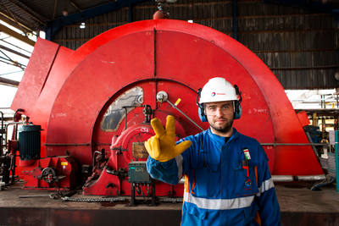
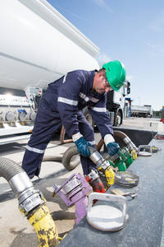
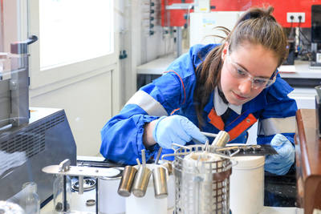
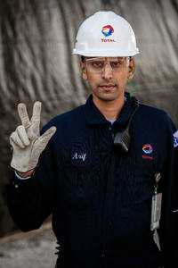
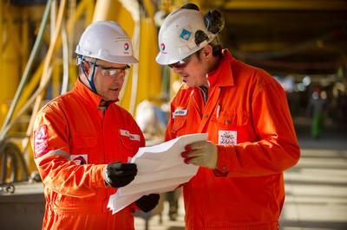
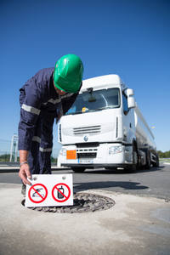
Guide of the welcoming manager
SafetyPass training

Slide 3
The first few days
in the Total Group
For you, welcoming manager, what is it about?
Recap of the approach in three points:
At the end of their first day in the Group, new recruits must be able to report that they were welcomed by a manager, who talked to them about safety. At Total, the induction starts with safety.
Day two is also dedicated to safety. New recruits should be thinking that “at Total, safety is definitely important”.
After these two days, new recruits are informed that safety concepts will be brought up again in more detail:
at three levels: Group, site and workplace,
in the three coming months,
including practical exercises and modules, like “life-saving practices” (how to use a fire extinguisher, using an AED, defensive driving, etc.).
This brochure is complementary to the guide for new recruits. It allows you to make these first days a privileged moment, focused on Safety as a core Value.
We hope you enjoy reading it!

Slide 4
DAY 1
Top Management Commitment (20 min)
Support media:
CEO video
Stop Card video
Total business card video
Safety as a core Value
(30 min)
Support media:
Road Safety video
Safety as a core Value video
The SSEQ Charter
(15 min)
Support media:
The SSEQ Charter
My entity’s Safety objectives
(30 min)
DAY 2
Completion of two e-learning modules:
Review with your new recruit
Send the chosen program to Gs.tls-hr4u@total.com (see more: ToolBox HSE; course 1 by default)
(*) 12 modules / 3h; if short in time, select the most relevant to the assignement
STEP IN!
Safety as a core Value
The 12 Golden Rules (*)
Within the coming three months
Monitoring training courses SafetyPass
At the end, hand over the signed SafetyPass to your new recruit.

