Slide 1
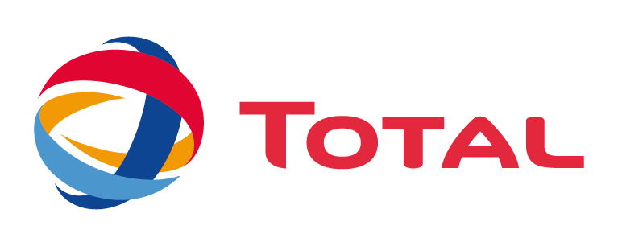
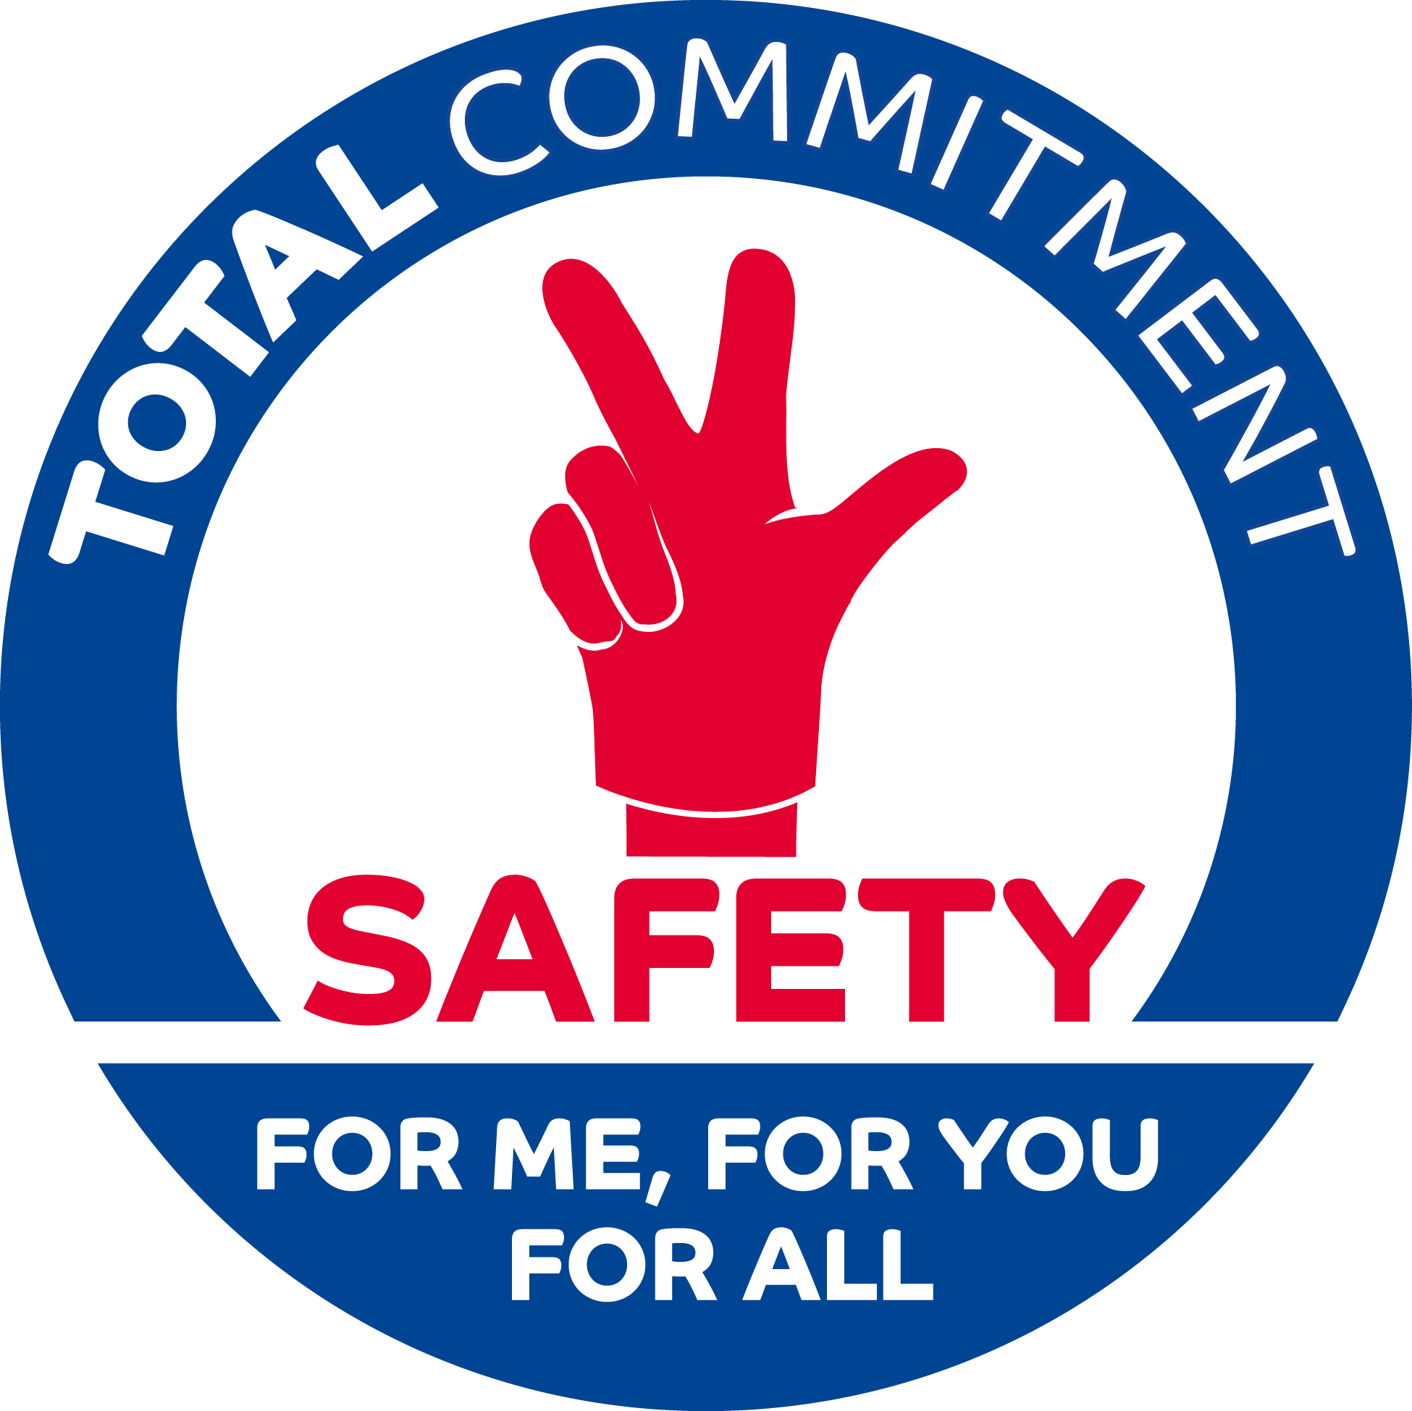
“Our Lives First : Joint Safety Tours” 30th April 2020

Slide 2
Contractors & our objective : Zero Fatal Accident
4 fatalities in 2019
Antwerp (RC – Refinery) : February
Normandy (RC – Refinery) : February
Oregon (GRP – Sunpower plant) : April
Sth Korea (RC JV – HTC plant) : Sept.
52%
Non Transport accidents
84%
are employees from contractors
48%
Transport accidents
Notes:
RC / Anvers - Belgique
Accident le 18 janvier (décès le 3/2) de Jorge
Chute d'une Plateforme Individuelle Roulante
RC / Normandie - France
Décès le 15 février de Cédric
Chute depuis un plancher d’installation industrielle
GRP / SunPower – Oregon, USA
Décès le 11 avril de Theodore
Chute d’un escabeau

Slide 3
Field presence and cooperation with our contractors
TOTAL
Internal Survey (2019)
40 %
Their manager only conducts safety tours on a quarterly basis or less
Contractors
Workgroup (2019)
Be more on the field
Talk the same language
Check compliance to your rules
Benchmark
Dupont (2018)
Best safety performers have developed three skills
- Challenge
- Observe tasks
- Reinforce rules

Slide 4
Joint Safety Tours
The new safety ritual of the Group
Joint safety tours imply:
Implementing a ritual like the safety moments
Being actively listening and visible in the field, through interactions with the workforce about their challenges
Being together: Group entities and affiliates with their contractors to share safety value
Focusing on high-risk activities: work at height, work on powered systems, lifting operations, work in confined spaces, hot work.
Who performs joint safety tours ? The entire management team
How often? Regular frequency (daily, weekly, monthly) is particularly important. It should not be a blocking point: common sense and practicality help overcome obstacles to go to the field.
Carry out
& step in
Report back
Follow-up
Prepare

Slide 5
MOVIE

Slide 6
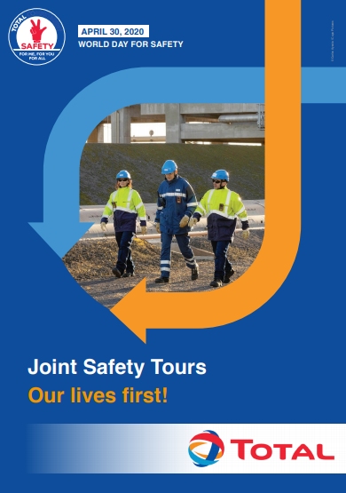
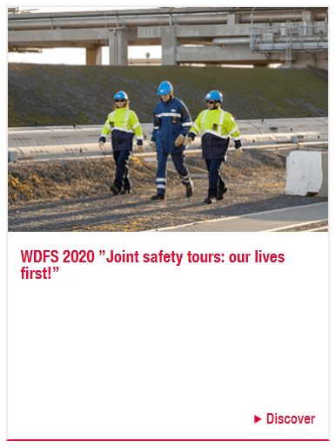
World Day for Safety
HSE Toolbox

Slide 7
“Our Lives First : Joint Safety Tours” 30th April 2020

