Slide 1
Our Lives First : Zero Fatal Accidents Sponsors’ training

Slide 2
AGENDA
Our lives first
Introduction
General Context
Presentation of « Safety Green Light »
Presentation of « Joint Safety Tours »
Presentation of « Life Saving Checks »
Deployment
Q&A
Conclusion
Notes:
Caroline
It is time to start our webinar
I am Caroline and I am very happy to welcome you to this webinar. Hello also to you Didier who is accompanying me to introduce this event
Didier
Hello Caroline and hello everyone and thank you to all of you who joined us in these very special circumstances.
With us, we have very talented colleagues who will do everything to make this remote meeting a success. Let me thank them in advance
Caroline could you tell me what is on the agenda for this Zero Fatality training
Caroline
As you can see on the slide, after this introduction Antonin will explain what is the context of this Zero Fatality course
Next, our colleagues of the Organizational and Human Factors Division will present the three main actions of the Zero Fatality project
Safety green light by Sébastien Roulier
Joint Safety Tours by Nicolas Durance
Life Saving Checks by Michiel De Koster
After that, Antonin, Didier and I will inform you on how we see the deployment of this Zero Fatality training course within your zones. This deployment won’t be very different from what was done for Mostorod (last year accident in Egypt).
Didier do you have one last word ?
Didier
Yes thank you Caroline. I just want to add a point or maybe just remember that the implementation of the three actions is at the heart of the 2020 HSE objectives of the MS branch and this is mandatory.
Antonin it is your turn now

Slide 3
Introduction Sponsors’ Training

Slide 4
General Context Sponsors’ Training

Slide 5
One primary objective – Zero Fatal Accident
4 fatalities in 2019
Antwerp (RC – Refinery) : February
Normandy (RC – Refinery) : February
Oregon (GRP – Sunpower plant) : April
Sth Korea (RC JV – HTC plant) : Sept.
52%
Non Transport accidents
84%
are employees from contractors
48%
Transport accidents
Notes:
RC / Anvers - Belgique
Accident le 18 janvier (décès le 3/2) de Jorge
Chute d'une Plateforme Individuelle Roulante
RC / Normandie - France
Décès le 15 février de Cédric
Chute depuis un plancher d’installation industrielle
GRP / SunPower – Oregon, USA
Décès le 11 avril de Theodore
Chute d’un escabeau

Slide 6
Workgroup : April 2019 – September 2019
Phase 1
Review the 2015 Workgroup actions
Members:
ORTEC, SIEMO SPIE, TOKHEIM Global Services, VINCI
10 TOTAL staff (Operations and HSE)
2300 Survey results + Test priorities
Phase 2
→ Shortlist practical actions /
→ Develop an implementation plan
Inputs of HSE specialists and various contractors
Phase 3
Detailed feasibility of an implementation plan for each branch

Slide 7
Striking survey results
Key figures: 2,300 responses, 700 contractor employees, 1,500 frontline workers and supervisors
20 %
Not aware of Group’s objective: « Zero fatal accident »
20 %
Did not stop any work for safety reason within the last semester
40 %
Their manager only conducts safety tours on a quarterly basis or less
50 %
Not controlled on a daily basis with regard to compliance to safety rules

Slide 8
what are contractors saying to management:
Get back in the field
Talk one language
Check compliance to your rules

Slide 9
Other surveys are saying
87 % of
High safety performing companies demonstrate maturity in three managerial practices:
Challenge
Take a step back when you perceive a risk
Observe
Perform safety observations
Reinforce rules
Provide feedback to ensure compliance with rules

Slide 10
The 3 actions
FOR WHICH:
Total will focus on the Top 5 fatal work risks (Work at height, LOTO, Hot work, Lifting, Confined spaces)
Contractors are key stakeholders
Contractors will partner in implementing the three actions
D – Day is April 30th (WDFS)
“Safety Green Light”
Joint Safety Tours
Life Saving Checks

Slide 11
QUIZ
What is the share of fatal accidents related to occupational safety on TOTAL sites in 2018 and 2019 borne by our contractors ?
50%
75%
100%

Slide 12
Safety Green Light Ambassadors’ Training

Slide 13
Why this tool?
« See something, say something » - Start / re-start ritual
To prevent active errors such as errors in applying rules or errors of diagnosis or “routine” errors but also latent errors (traps set in the organization, for example: it is not the right equipment or it is not made available).
To increase situational awareness
The time allocated to stop allows to think, reassess and remember the task to be performed. It avoids to rush.
The open questions give time and rooms for each worker to say something, to intervene
It reinforces the use of the Stop Card
The brain has the tendency to work in « routine » mode. A way to exit this mode to a « conscious » mode is to ask open questions to create the vigilance and the reflection.

Slide 14
What is the tool?
SAFETY GREEN LIGHT?
What: pre-job ritual to reflect on life-threatening hazards
Who: all personnel involved in the task including Total personnel if present
Where: on all sites (including remote) for all works performed under a permit-to-work
When:
Every job under a work permit
Everything is ready to start a job
Every time a job is about to start, to re-start, after a shift handover and any modification
How long: few minutes, must be quick
How:
Standard included in HSE Company Rule related to Permit to Work (CR-GR-HSE-402)
Each worker reflects on the four questions and interact with his co-workers
Each worker signs at the back of the permit-to-work prior to starting
1
What is the job to be done?
At what exact location?
Do I understand my role and am I able to do it? Have the procedure and work permit been explained to me?
Do I have the right tools/protective equipment's for the work?
2
What should I do if change occurs?
Change in conditions (environment, co-activities, etc.) during the course of work (need for a tool not initially planned, operating procedure or risk not initially identified, etc.)?
3
What could happen that could be serious?
Is there a risk of a fatal accident?
Can someone hurt me or can I hurt someone?
What will protect me?
I am ready to start my work safely
START
I have doubts
STOP
4
I report to my team leader

Slide 15
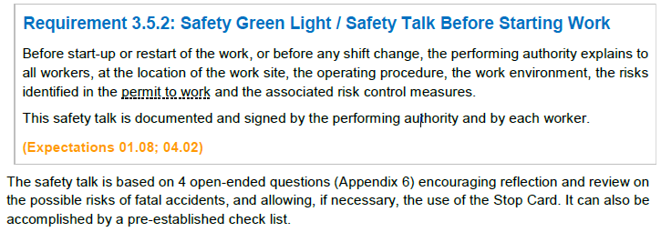
What is mandatory, what is recommended ?
The Company Rule - Permit to Work process
This action is made mandatory by the CR GR HSE 402 rule (Requirement 3.5.2).
Existing site documents in terms of work start-up review (LMRA type, minute to think, tool box talk, etc.) must be adapted and uniformized to be in line with the safety green light
The format used to animate the safety green light is not mandatory.

Slide 16
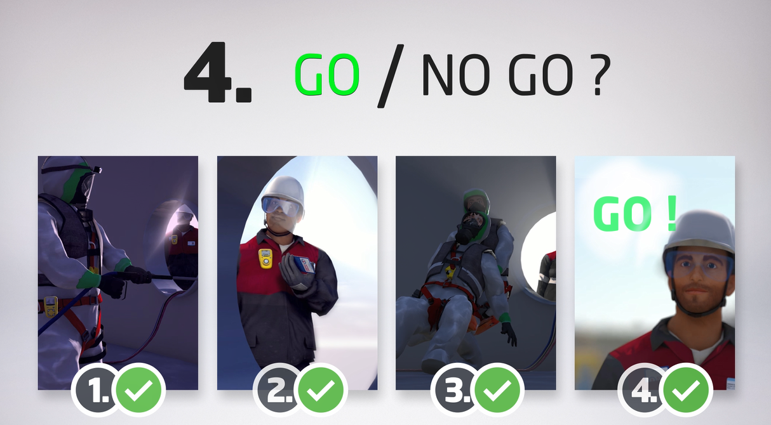
Video safety green light

Slide 17
In short
Last time to say something, verify, say STOP
Focus life-threatening hazards
Need to promote that ritual, be exemplary, show how to do it
Keep it simple and quick, use the video as an example, display the 4 open questions

Slide 18
Joint Safety Tours Ambassadors’ Training

Slide 19
What is at stake ?
The need to be more visible in the field :
To observe, to perceive, to dialogue, to exchange : transparency & active listening
Jointly, Total with its partners, to see and be seen : proximity
With a special focus on high risk works : prevention of fatal accidents
To demonstrate the commitment : at all management levels
Regularly : a ritual

Slide 20
What is requested ?
Who, what, when and how :
Team Manager – Senior Manager – General Manager
A joint site visit
1 / month
Common methodology in 4 steps :
Carry out
& step in
Report back
Follow-up
Prepare

Slide 21
What is mandatory ?
And for who ?
To establish a list of personnel concerned :
Team Manager Premier niveau / Responsable d’équipe de jour / Superviseur d’unité / Chef d’équipe / Installation Manager / Site supervisor
First level Team Manager / Day shift Manager / Unit Supervisor / Team Manager / Installation Manager / Site Supervisor
Business ou Senior Manager / Management intermédiaire / Conducteur de travaux / Project Manager / Field Operation Manager
Business or Senior Manager / Intermediate Management / Operating Authority / Project Manager / Field Operations Manager.
Directeur général / CODIR de site ou filiale / Directeur d’agence
Managing Director / Site or Affiliate Management Committee / Office Manager
A frequency of at least once a month for all personnel in the entity concerned
To focus on the zero fatality

Slide 22
In short
In the field, not behind the screen
Together, Total with its partners
Focus on high risk works : fatalities of 2019 triggered this initiative
Keep it simple : start with the inventory of existing processes & use existing tools
A4 summary sheet & guide will be provided : currently under review

Slide 23
Life Saving Checks Ambassadors’ Training

Slide 24
why
The objective is to carry out field checks on the basis of specific checklists in order to prevent fatal accidents.
These field checks cover at least the 5 most important life-threatening activities for TOTAL:
Work at height
Work on isolated systems, incl. isolation activities
Lifting operations
Working in confined spaces
Hot work

Slide 25
who
Field checks are carried out by TOTAL or Contractor personnel. These field checks are not necessarily carried out jointly (TOTAL with Contractor).
Field checks are carried out by first level supervisors, middle managers, top management, HSE or any other controller identified/designated by each party.

Slide 26
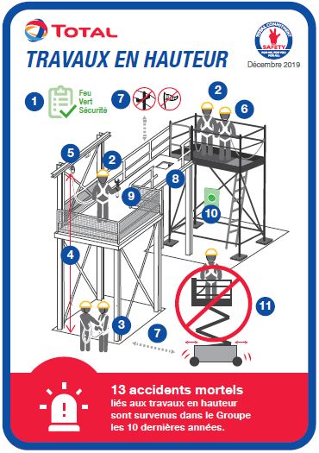
Where, when & how
The checks are carried out in the field, where the life-threatening activity takes place.
The observation of life-threatening activities is done during the execution of works.
Field checks of a life-threatening activity are brief (15’) in order to increase their number.
The use of checklists and associated diagrams helps to observe non-conformities. In this case, the controller intervenes and stops the work in progress.
The compliance rate is assessed based on the verification of the points of the checklists.

Slide 27
Where, when & how
Field checks do not record the names of individuals but only that of the company observed (TOTAL or Contractor company).
The results of these field checks are recorded in a common system.
The affiliates and the entities themselves set the target for the number of field checks to be carried out per month by the stakeholders (TOTAL and Contractors).
The results of field checks are consolidated on a weekly basis with a local display of the compliance rate per company (TOTAL and Contractors)
The purpose of the display is to inform in order to identify the most vulnerable safety conditions and to progress collectively.

Slide 28
What is imposed, what is optional
Imposed:
The implementation of daily field checks for at least the top 5 of life-threatening activities.
Monitoring of associated KPIs.
Optional:
The content of the checklists.
The format of the checklists. Models of checklists are made available to entities/affiliates to guide them as best practice.

Slide 29
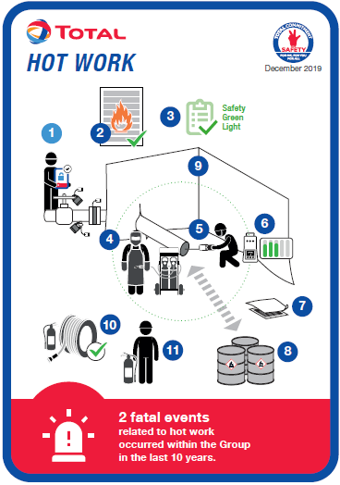
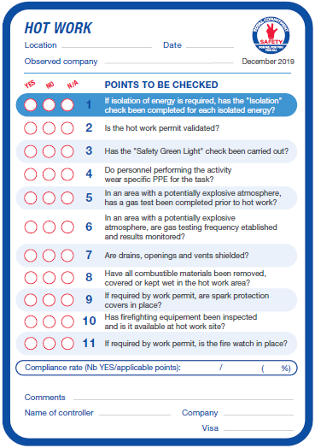
TOOLS
Example of a checklist:
Diagram representing the life-threatening activity and the points to check
Checklist of points to check on the life-threatening activity
Name of the observed company, not of the personnel involved
Numbered points to check, corresponding to the questions in the checklist
Non-compliant point
= stop
actvity
Reminder of the number of fatal accidents linked to the respective activity
Calculation of the compliance rate on the total of the points checked and applicable

Slide 30
QUIZ
What do I have to do if I observe a non-conformity, according to one of the points on a checklist ?
I tick the box of the non-conformity on the checklist and continue to verify the other points in the list
I intervene : that can mean anything from asking a simple question to make sure there's no danger, to stopping the work

Slide 31
QUIZ
Are the checks carried out only by specialists in the activity ?
Yes
No

Slide 32
Implementation Ambassadors’ Training

Slide 33
Three actions proposed
“Safety Greenlight”
Establish, as a part of the PTW, a Group-wide pre-work ritual focused on the prevention of fatal accidents
Joint Safety Tours
Generalize and increase the number of safety tours carried out with our Contractors
Life Saving Checks
Strengthen and increase on-site checks to measure compliance to our rules, with a view to strengthening fatal accident prevention
Communication Effort
Increase awareness on life-threatening hazards as well as support the implementation of proposed actions

Slide 34
Implementation strategy
HSE Division will prepare for and with the Branches
Implementation kits including required tools
Webinars, Guides and Manuals
Training programs including Branch specifics
Specific material to reach out Contractors personnel
Branches will define their deployment strategy and get approval from their Steering Committee
A group of ambassadors will be set up to reach out for the entire Group and Contractors
HSE Branch team members
Auditors
HSE specialists
Branch personnel whenever adequate
Critical part of the puzzle : Contractors
Induction sessions at Group Level
World Day for Safety : Joint Safety Tours
Local contributions to implement the actions
Deployment will include a reinforcement of aspects related to CR-GR-HSE-402 : Permit to Work

Slide 35
Implementation plan
2019
2020
2021
Q3
Q4
Q1
Q2
Q3
Q4
Q1
Q2
Q3
Contractor Safety Day
Group HSE committee
Suppliers’ day
WDFS
WDFS
Communication campaigns
Work at height
Hot work
Safe isolation
Lifting
Confined Space
Joint Safety Tours
Safety Green Light
Guide
Pilots and
Site feedback
Life Saving checks
Front-end Engineering
Detailed Engineering
Implementation kit completed
Communication campaign kick-off

Slide 36
KPIs at Group level
3 KPIs
Safety Green Light : # affiliates who have implemented the Safety Green Light
Joint Safety Tours : # joint safety tours performed
Life Saving Checks : # compliance checks performed
Monthly
By Branch
Computed for the entire Group

Slide 37
Implementation stages
December 2019: Kick-off of implementation within all Branches
January 2020: Review within each Branch of specific needs in terms of training material and tools
February 2020: List of ambassadors completed and Information of Group Contractors
March 2020: Kick-off of ambassadors’ training, including contractors based on Branches request
April 2020: World Day for Safety “Joint Safety Tours, Our Lives First”
May 2020: Communication on high risk activities “Work at height”
Q2 2020: Gradual implementation of “Safety Green Light” and “Life Saving Checks”

Slide 38
Wdfs 2020 – safety performance
Alain, Karim and Sabry from Contractor companies did not return home in 2018.
Jorge, Cédric, Théodore and Eung Yoo from Contractor companies did not return home in 2019.

Slide 39
QUIZ
What is the action selected for the World Day for Safety in 2020?
Joint Safety Tours
Life Saving Checks
Safety Green Light

Slide 40
QUIZ
What is the implementation planning for the “Safety Green Light” and “Life Saving Checks”?
It is compulsory to implement the three actions on 30/04/2020 too
After the WDFS based on the affiliate-defined schedule
It is not compulsory to implement these actions

Slide 41
QUIZ
How are contractors involved in the implementation?
They will comply with what TOTAL requests them to do
They are not involved
TOTAL and its contractors will collaborate to implement locally

Slide 42
Q&A Sponsors’ Training

Slide 43
Conclusion Sponsors’ Training

Slide 44
Our Lives First : Zero Fatal Accidents Sponsors’ training

